Slide 1


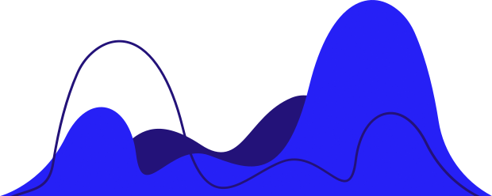
Stock Price Prediction via Market Emotion
Submitted by
Abhinav (1803010008)
Anshika Gupta (1803010035)
Ashutosh Kumar (180010051)
Project Guide: Ms. Shivani Sharma

Slide 2
40
30
20
10
0
21st
22nd
23rd
24th
25th
26th
Stock market is subject to market risks, because it depends on Physical as well as Psychological Factors, rational behaviours and irrational behaviours, all of this combined.
This makes the stock market volatile and difficult to predict.
This project aims to design a Machine Learning Model which can unearth the underlying patters between the stock price and the factors such as the latest announcements about the organization and there quarterly revenue etc. that affect the stock price.
Objective

Slide 3

Novelty
of the Project
In the current scenario, the stock prediction is mostly based on physical factors such as the pattern in the stock price history.
The proposed system will try to understand the pattern between the specific hikes/downfall in the market and the on-going buzz about the "Stock" on table.
This method of Stock prediction can not only predict the usual stock price for a specific stock, but can also alert about Price-hikes and downfalls.
Stocks Price Prediction

Slide 4
Literature Review
Jasic and Wood(2004):
Jasic and Wood (2004) developed an artificial neural network to predict daily stock market index returns using data from several global stock markets.
A method is introduced based on univariate neural networks using untransformed data inputs to provide short-term stock market index return predictions. The study uses the daily closing values of the Standard and Poor’s 500 Index (S&P 500), the German DAX Index, the Japanese TOPIX index, and London’s Financial Times Stock Exchange Index (FTSE All Share). The samples for the S&P 500, DAX and FTSE Index are from January 1, 1965 to November 11, 1999. The sample for TOPIX covers the period from January 1, 1969 to November 11, 1999 since data from earlier years was not available.
The prediction performance for the neural network is evaluated against a benchmark linear autoregressive model and prediction improvement is confirmed when applied to the S&P 500 and DAX indices.

Slide 5
Literature Review
Liao and Wang, 2010:
It is presumed that investors choose their investment positions by analyzing historical stock market data, and the historical data are given weights based on how near they are to the present.
The nearer the historical data time is to the present, the stronger the impact the data have on the predictive model. The model’s effectiveness is analyzed using a numerical experiment based on data from each trading day in an 18-year period from December 19, 1990 to June 7, 2008.
The data is from several stock markets including the Shanghai and Shenzhen Stock Exchange Stock A Index (SAI), Stock B Index (SBI), and the Hang Seng (HIS), Dow Jones Industrial Average (DJIA), NASDAQ Composite (IXIC) and S&P500.
The forecasting performance of the model is assessed using various volatility parameters.

Slide 6
Literature Review
Chong, Han and Park (2017):
They analyzed deep learning networks for stock market analysis and prediction. Deep learning networks extract features from a large set of raw data without relying on prior knowledge of predictors which makes it useful for high frequency stock market prediction.
They provide an objective assessment of both the advantages and drawbacks of deep learning algorithms for stock market analysis and prediction.
Using high-frequency intraday stock returns as input data, they examine the effects of three unsupervised feature extraction methods—principal component analysis, autoencoder, and the restricted Boltzmann machine—on the network’s overall ability to predict future market behavior.
Testing is done using data from 38 companies listed in the Korean KOSPI stock market from the period January 4, 2010 through December 30, 2014.

Slide 7
Proposed
Methodology
There are various factors that will be affecting the predicting the stock price in the proposed model.
Firstly the Historic Data, as it plays a vital role in the stock market.
All the hikes and Downfalls in the historic data will be linked to the news/tweets/posts/announcements of the organisation and the affect will be understood.
The stock closing and opening price of the given stock will be predicted using the historic data and the "weighted" affect of the announcements and news on-going about the organisation.
Stock Price Prediction

Slide 8

Requirements
Hardware Requirements
Software Requirements
Operating System:
Development - Linux/Windows
Application - Platform Independent (Browser)
Machine Learning Technologies
Tensorflow JS
Brain.js
ml5js / Synaptic
Backend Technologies
NodeJS
ExpressJS
Front-end Technologies
ReactJS
Bootstrap
System Memory: 8 GB RAM v2 Shared CPU
Graphic Memory: 2GB Minimum
Hard-disk Space: 3GB

Slide 9
Module Description
Simple Moving Average (SMA) is a technical analysis method usually used to analyze and develop inferences models from financial data. SMA method takes the average of all the values within a time window and identifies the trend direction for that time window .
We are using a complex Time-series analysis, which takes into accounts various holidays and irregularity.
We also use pystan for statistical modeling.
The Data-set for Historical Data will be taken from APIs.

Slide 10
Description of Project
The Project utilises a two way approach in which there are two components a web application which directly interact with the user, and a time-series based statistical model which does the forecasting.
We use the simple procedure for forecasting time series data based on an additive model where non-linear trends are fit with yearly, weekly, and daily seasonality, plus holiday effects.
A simple intuitive web-application

Slide 11
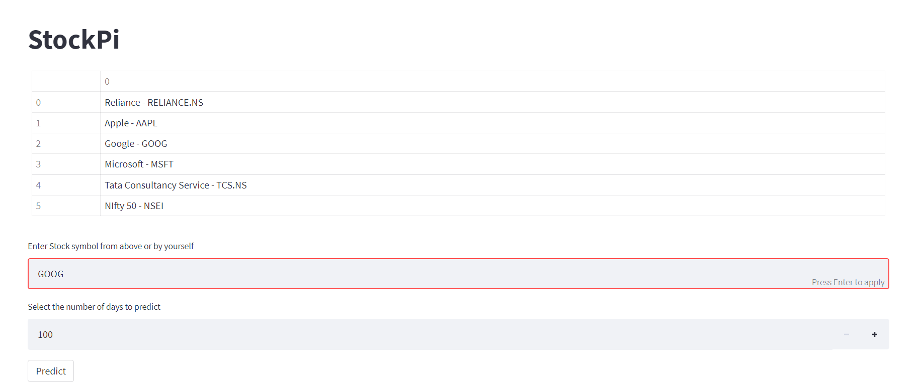
Implementation Snapshot

Slide 12
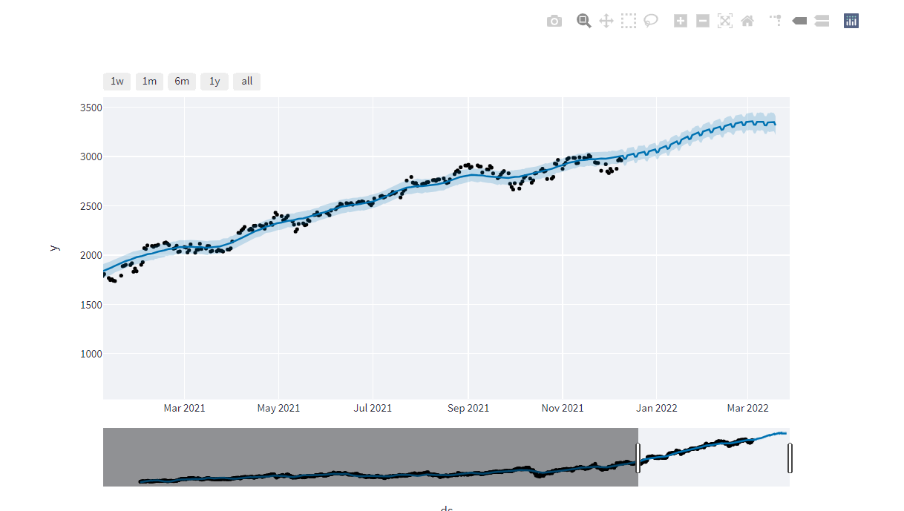
Implementation Snapshot

Slide 13
Implementation Snapshot

Slide 14


Future Scope
Market Emotion effects
We are able to predict the future value of stock to pretty much accuracy but to add more accuracy to it for instance stock like AAPL have a specific range where the effect of market is disturbing the data.
Alert on Hikes/Downfalls (User accounts)
The Complete project should be able to predict the sudden hikes and downfalls in the given stock.

Slide 15
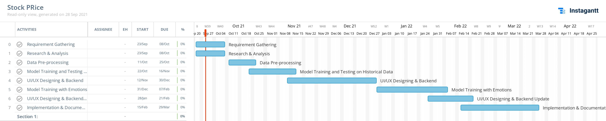
Timeline of Project

Slide 16
References
[1]. Teo Jašić, Douglas Wood: The profitability of daily stock market indices trades based on neural network predictions: case study for the S&P 500, the DAX, the TOPIX and the FTSE in the period 1965-1999. Applied Financial Economics, 2004, vol. 14, issue 4, 285-297.
[2]. Zhe Liao, Jun Wang: Forecasting model of global stock index by stochastic time effective neural network. Expert Systems with Applications, Volume 37, Issue 1, January 2010, Pages 834-841.
[3]. Eunsuk Chong, Chulwoo Han, Frank C. Park: Deep learning networks for stock market analysis and prediction: Methodology, data representations, and case studies. Expert Systems with Applications, Volume 83, 15 October 2017, Pages 187-205.

Slide 17
References
[4]. Taylor SJ, Letham B. 2017. Forecasting at scale.
[5]. Aparna Nayak, M. M. Manohara Pai, Radhika M. Pai, Prediction Models for Indian Stock Market, Procedia Computer Science, Volume 89, 2016, Pages 441-449, ISSN 1877-0509.
[6]. Patil, Rajat. (2021). Time Series Analysis and Stock Price Forecasting using Machine Learning Techniques. 19. 10.1994/Rajat/AI.
[7]. Mehtab, Sidra & Sen, Jaydip. (2020). A Time Series Analysis-Based Stock Price Prediction Framework Using Machine Learning and Deep Learning Models.

Slide 18



Thank you

